Slide 1
Transcript Intelligence Platform
Insights from 100 Enterprise Meeting Transcripts
Dhanaraj (Raj) Patil
Senior Software Engineer

Slide 2
Objective
Build a transcript intelligence pipeline that converts unstructured transcript data into actionable business insights.
Goals: • Normalize transcript data • Categorize meetings into business themes • Analyze sentiment trends • Detect operational risks

Slide 3
Dataset Overview
100 enterprise meeting transcript folders analyzed. Available data included:
• Meeting Metadata • Full Transcript • Summary
• Topics • Sentiment Scores • Action items • Speaker metadata

Slide 4
Technical Pipeline
1. Load transcript JSON files 2. Normalize into structured pandas dataframe 3. Extract transcript metadata
4. Categorize meetings using topic/keyword 5. Analyze sentiment and operational trends 6. Generate business insights and risks

Slide 5
Key Findings
• 67% meetings were Support / Incident related • 33% focused on Competitive Intelligence • Most meetings were mixed-positive or mixed-negative
• Competitive meetings had lower sentiment scores • Outages, compliance, and security were dominant themes

Slide 6
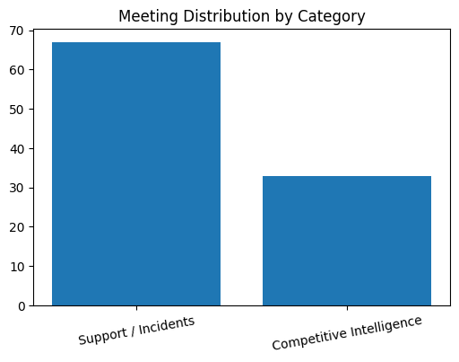
Meeting Distribution by Category

Slide 7
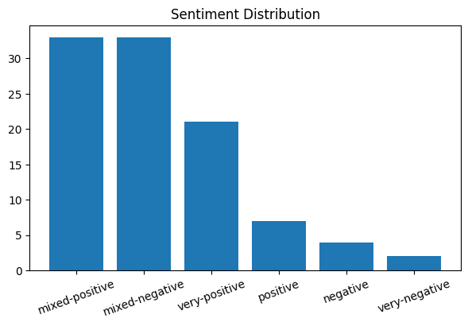
Overall Sentiment Distribution

Slide 8
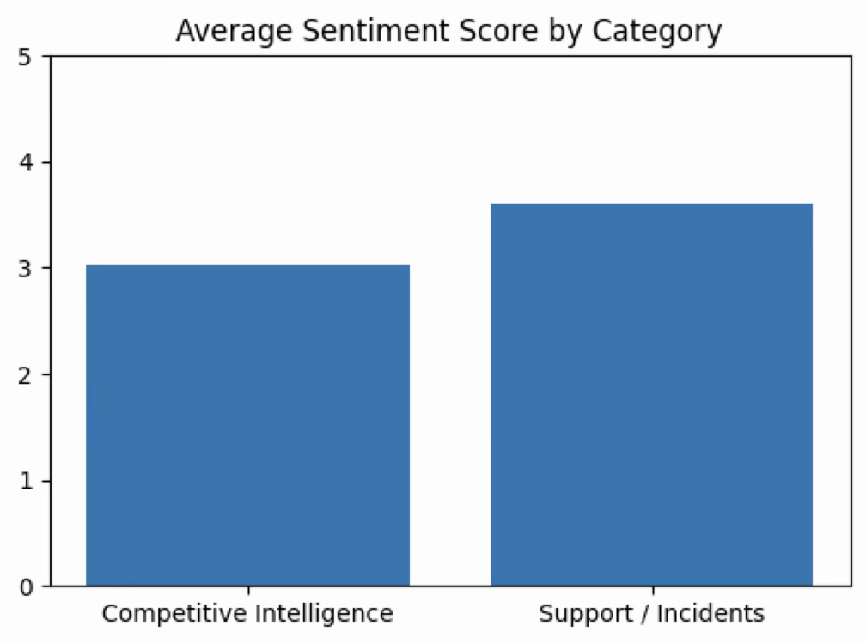
Average Sentiment Score By Category

Slide 9
Recurring Themes Identified
Top recurring themes across transcripts:
• Compliance (61 mentions)
• Security (60 mentions)
• Reporting (56 mentions)
• Outage (46 mentions)
• Feature Requests (42 mentions)
• Integration Challenges (38 mentions)
• Roadmap Discussions (37 mentions)

Slide 10
Operational Risk Signals
• 46 outage-related discussions • 31 renewal-related discussions • 17 escalations
• 25 risk-related mentions • Negative sentiment strongly correlated with outages and escalation meetings

Slide 11
Business Insights
Key observations:
• Competitive Intelligence meetings had lower sentiment scores (3.03)
• Support / Incident meetings dominated operational workload
• Longer meetings correlated with higher sentiment scores (0.36 correlation)
• Action item counts remained consistently high across all meeting types

Slide 12
Potential Business Value
Transcript intelligence can help:
• Detect customer risk earlier
• Prioritize recurring product pain points
• Identify operational instability trends
• Improve executive visibility into customer issues
• Support roadmap prioritization using customer evidence

Slide 13
Future Enhancements
Potential next steps: • LLM-powered clustering • Semantic search over meetings • Real-time transcript analysis • Automated customer risk scoring
• AI generated executive summaries

Slide 14
Conclusion
The project demonstrates how unstructured enterprise meeting transcripts can be transformed into structured operational and business intelligence using scalable analytics pipelines.

